Slide 1

MISINFORMATION OR FAKE NEWS DETECTION IN SOCIAL MEDIA SPACES
VINAY PANDEY - SEC A - ROLL NO. 71
UNIVERSITY ROLL NO. 2019229
MENTOR - DR. ASHWINI KUMAR SINGH , PROFESSOR

Slide 2
INTRODUCTION
Misinformation appears in a variety of ways, such made-up news, altered pictures, or false statements. Because of its quick sharing capabilities, social media is a perfect environment for spreading false information because viral content may quickly reach millions of people. This presents serious problems.
Misinformation/Fake news detection refers to the process of using various analytical and classification models to forecast whether a given news could be potentially fake or real. This can involve analyzing other fake and real news data, while reading for key details which distinguish fake ones from real ones
We are using a dataset of news extracted from various sources which contains fake as well as real news from multiple social media spaces to which includes factors like ID, Title, News Article and Label, which is all converted from various formats to text format and stored in a .csv file. We use this dataset to train our Machine Learning Model to Detect whether a news given to it is fake or real.

Slide 3
In this project, we will be utilizing a machine learning model, which is created using Natural Language Processing (NLP) and Passive Aggressive Algorithm. It is a classifier known as Passive Aggressive Classifier which helps us classify whether a given news is fake or real. It includes a variety of online learning algorithms used for binary classification tasks, in this case Fake or Real.
This application would be really helpful to masses in order to recognise what information online is fake and what is real, allowing them to choose and make decisions wisely as well as allowing tech companies to remove such content and creators from their platforms creating a much safer environment and prevent the spread of misinformation across the web.

Slide 4
METHODOLOGY
PYTHON
JUPYTER NOTEBOOK
SCI-KIT
LEARN
TOOLS AND TECHNOLOGIES USED
PICKLE
TF-IDF
PASSIVE AGGRESSIVE CLASSIFIER

Slide 5
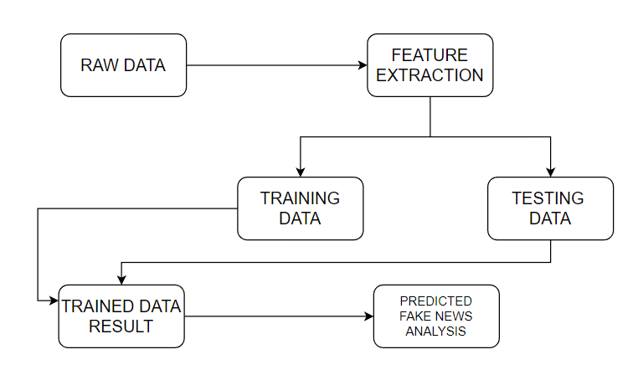
PROPOSED WORKFLOW
The system of this project here is composed of five main steps:-
1. Input as Dataset
2. Pre-processing
3. Data Splitting - Train and Test
4. Vectorizing Text using TF-IDF
5. Building and deploying Fake News Detection Model

Slide 6
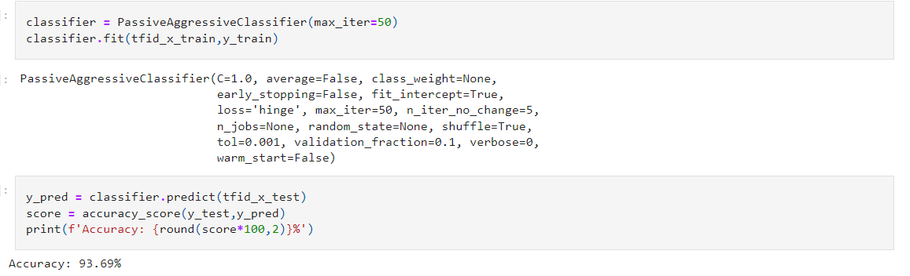
Data of the News Articles and Labels have been taken from a website named Kaggle. The data is then cleaned, scaled accordingly, and then split into training and testing datasets, after which a TF-IDF vectorizer is used to perform NLP on the data whose vectored values are then used to train our Passive Aggressive Classifier Model.
The above figure shows the code for the Passive Aggressive Classifier Model with a 93% accuracy on test data. This model will be built into a function for easier use with new data.

Slide 7
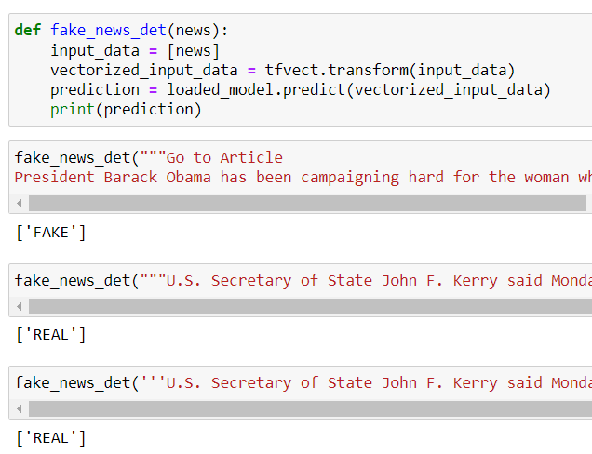
RESULT AND DISCUSSION
By following the described methodology, a TF-IDF Vectorizer was used to extract word weight using Natural Language Processing (NLP) whose output was used to train a Passive Aggressive Classifier which can tell with a good accuracy about whether a particular news is fake or real. Since we used an PAC model, we are able to achieve this with a sequential stream of data . Utilizing this model for testing on some cases of news is given below
IMPLEMENTATION AND RESULT OF FAKE NEWS FUNCTION

Slide 8
The implementation of this classifier model has the potential to assist numerous platforms in detecting fake news from real news, thereby helping them be more credible and safe. Nonetheless, despite the prevalence of various highly accurate machine learning models, it is essential to recognize that the models are not effective in all scenarios are are susceptible to errors. Therefore, social platforms should issue a warning of possible error before conveying it to the users, and not solely rely on these systems for decision-making, which goes for false positives as well. Strategies like cross checking from credible sources and user polling for a content to be fake could also be used to be definitive of a news or post being false.

Slide 9
CONCLUSION AND FUTURE WORK
Through this project, I have developed a system that can predict if a news is likely to be fake or real fairly accurately based solely on the content information. It has the potential to be applied to various fact checking and social media platforms to ensure the validity and credibility of the user generated content and maintain a better standard of content for these platforms.
However it is important to note that the model is based on a single parameter and multiple parameters would ensure that the results being generated are fairly accurate, also the facts and news should be independently fact checked and fed to the model so that it can get better over time, because the model cannot predict the credibility with hundred percent accuracy and serves to provide a general idea of falseness or trueness surrounding any given news or fact.

Slide 10
THANK YOU

